Slide 1
EE4007 - Optical Electronics
Lecture 17 – Photodetectors II
© Alan P. Morrison
March 2009

Slide 2
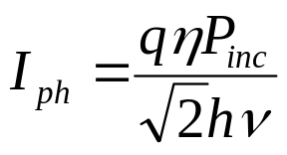
Noise performance
Dark current very small
Shot noise caused by generation within depletion region
Resistance (Johnson) noise dominates - can minimise this by optimising circuit parameters
rms photocurrent given by:
Background photocurrent, due to ambient light, I_{B}
Dark current due to thermally generated electron-hole pairs, I_{D}
These all contribute to random fluctuations in the output current - shot noise. Equivalent noise current expressed as:
© Alan P. Morrison
March 2009

Slide 3
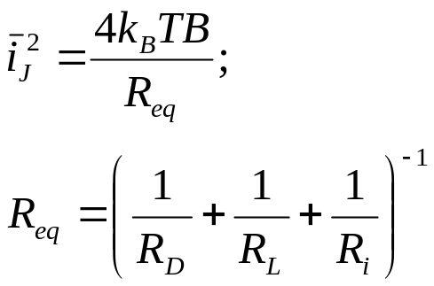
Noise performance
Johnson noise is due to the various resistance in the diode equivalent circuit. Mean square noise current given by:
Calculate S/N ratio:
R_{S} usually small and neglected
R_{i} = input resistance of preamplifier
© Alan P. Morrison
March 2009

Slide 4

Noise performance
Noise Equivalent Power (NEP): when rms signal power = NEP, the photocurrent is equal to the noise current and S/N ratio is 1.
NEP is calculated for a bandwidth of 1 Hz.
© Alan P. Morrison
March 2009

Slide 5
Noise performance
To increase sensitivity of photodiode, efficiency and equivalent resistance should be as large as possible, and I_{B}, I_{D} should be as small as possible.
NEP is a measure of the minimum detectable power.
© Alan P. Morrison
March 2009

Slide 6
Avalanche photodiodes
APDs exhibit internal optical gain by process of impact ionization
  charge carriers generated within the depletion region or within one diffusion length of the depletion region of the device are accelerated by the very high electric field.
  If the electric field exceeds the critical field required for ionization to occur then secondary carriers can be produced by collisions with the semiconductor lattice
  these secondary carriers are also accelerated and may produce additional carriers by further impact ionization
  this leads to an avalanche current being produced with the avalanche gain of the order of several hundred
  APDs are biased close to the device breakdown to ensure the electric field is sufficiently high to cause impact ionization
© Alan P. Morrison
March 2009

Slide 7
Avalanche photodiodes
Avalanche process is asymmetric - one carrier dominates, either electrons or holes. In silicon ionizing collisions are 30-50 times more frequent with electrons than holes.
Asymmetry is characterised by impact ionization coefficients for electrons and holes, α_{e}, α_{h}
In general we want a material where impact ionization coefficient for one type of charge carrier is much larger than that of the other type. e.g. Si has α_{e} >> α_{h}
Gain is characterised by a multiplication factor, M
© Alan P. Morrison
March 2009

Slide 8
Avalanche photodiodes
Requirements for practical APD:
  multiplication area must be defect free, defects are introduced during processing of the device
  defects give rise to microplasmas which are regions where the breakdown occurs at voltages lower than the rest of the junction
  reduce defects by limiting device area
© Alan P. Morrison
March 2009

Slide 9
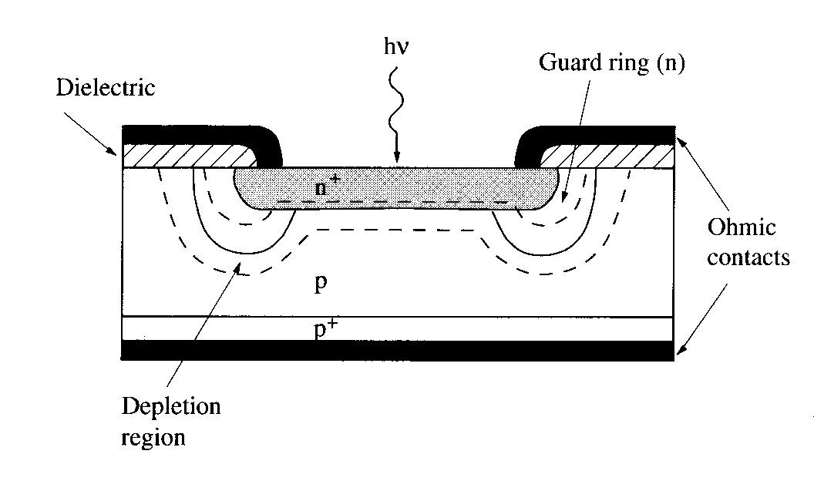
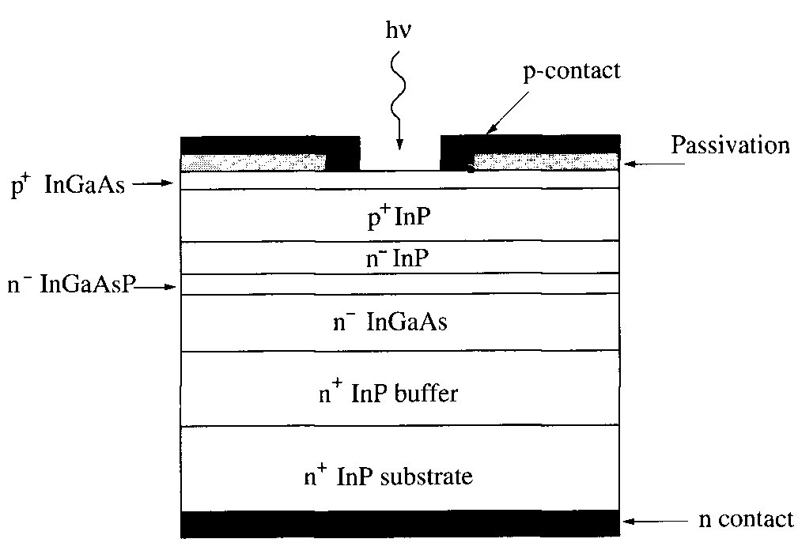
Avalanche photodiodes
Two different avalanche devices:
Guard-ring Si-APD
InP based separate absorption and graded multiplication APD
© Alan P. Morrison
March 2009

Slide 10
Geiger Mode Avalanche Photodiodes
These are APDs operated above breakdown
Peak electric field is close to critical field for material
Single charge carrier sufficient to initiate self-sustaining avalanche current
Requires specialised circuitry to operate effectively
Capable of detecting single photons of light
© Alan P. Morrison
March 2009

Slide 11
Device Evolution
    Process and device simulation
    Process development
    Process characterisation
      Scanning Electron Microscope (SEM)
      Spreading Resistance Profile (SRP)
      Secondary Ion Mass Spectroscopy (SIMS)
      Defect etch and analysis
    Mask design Automated full wafer electrical device characterisation
    Dark count measurement
© Alan P. Morrison
March 2009

Slide 12
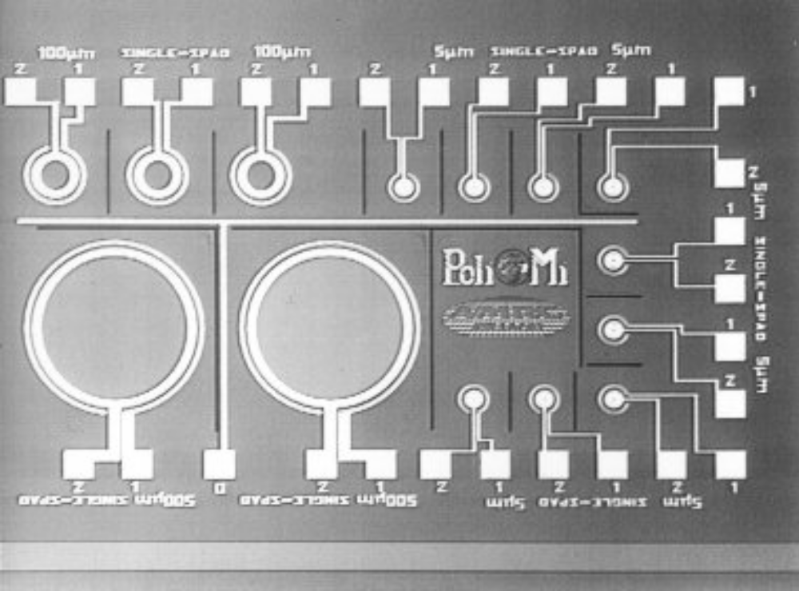
Mask design and layout
Various single SPAD
devices.
Sizes ranging from
2μm to 500μm in
diameter
© Alan P. Morrison
March 2009

Slide 13
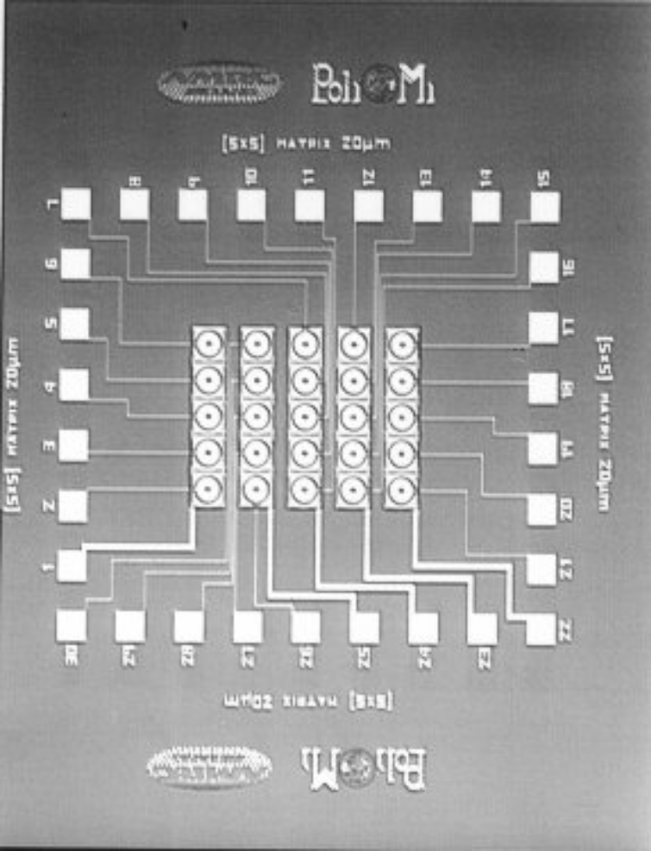
Challenge to produce 1-D and 2-D
SPAD arrays.
Layout for 1 x 10, 3 x 3, 5 x 5 and
10 x 10 arrays of SPADs
Strategies proposed for optical
isolation
© Alan P. Morrison
March 2009

Slide 14
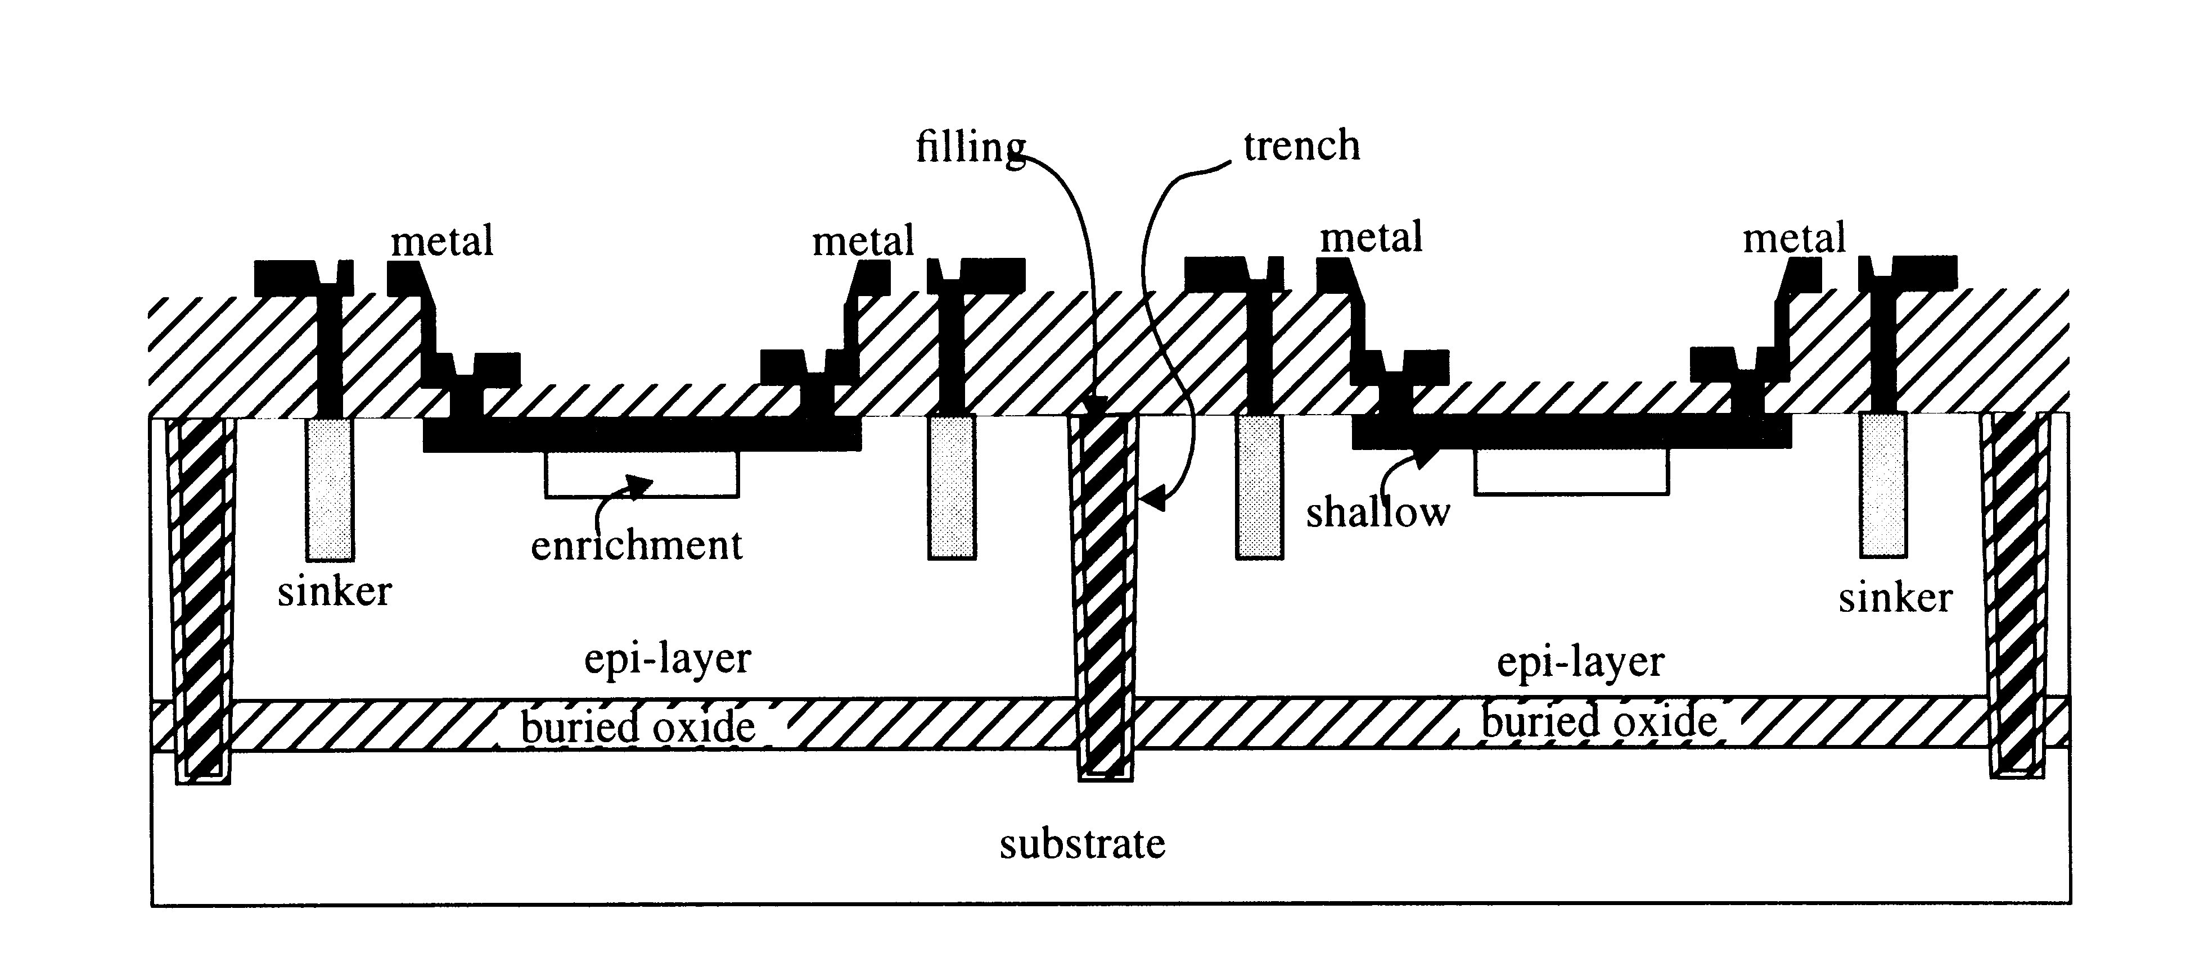
© Alan P. Morrison
March 2009

Slide 15
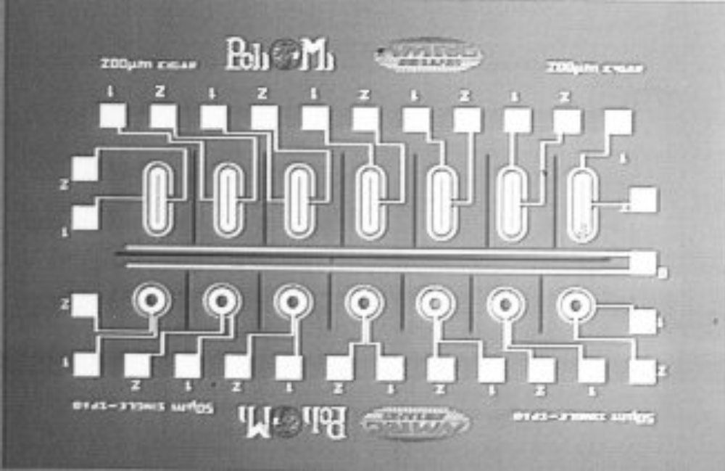
Linear arrays of “sausage” shaped and circular SPADs
© Alan P. Morrison
March 2009

Slide 16
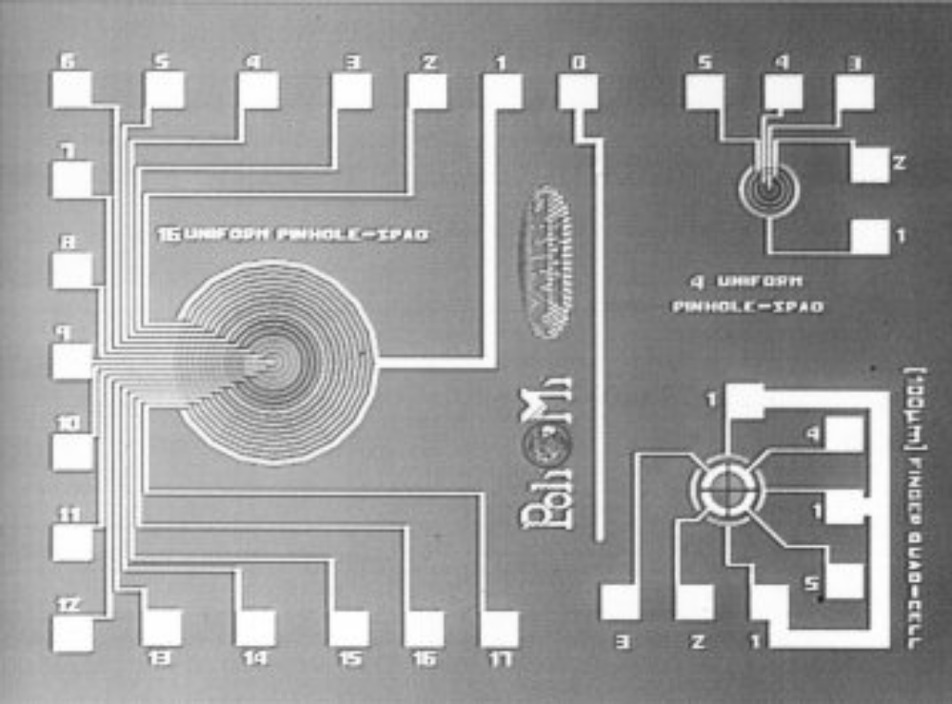
Complicated SPAD structures - variable pinhole and quad-cell
SPAD devices.
© Alan P. Morrison
March 2009

Slide 17
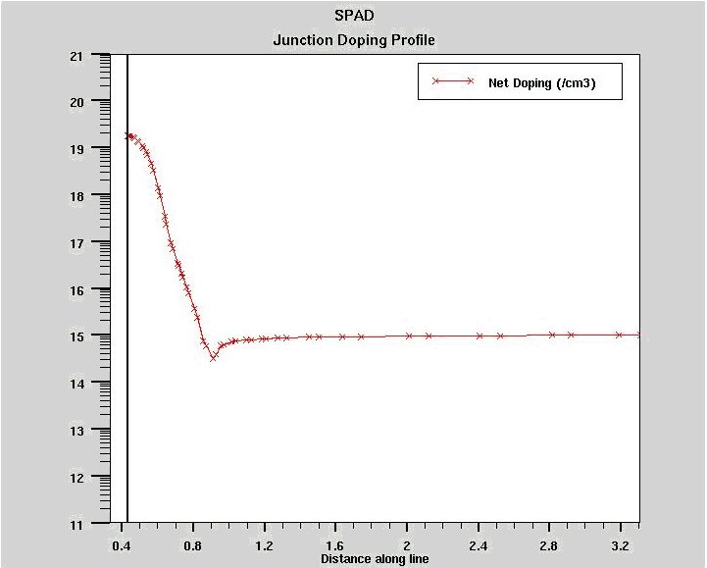
1-D Simulation - Junction doping profile
© Alan P. Morrison
March 2009

Slide 18
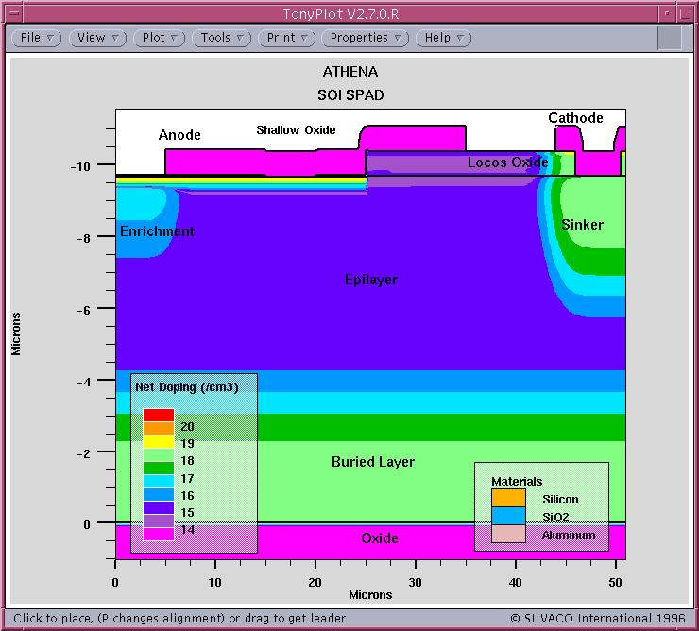
2-D Process simulation
© Alan P. Morrison
March 2009

Slide 19
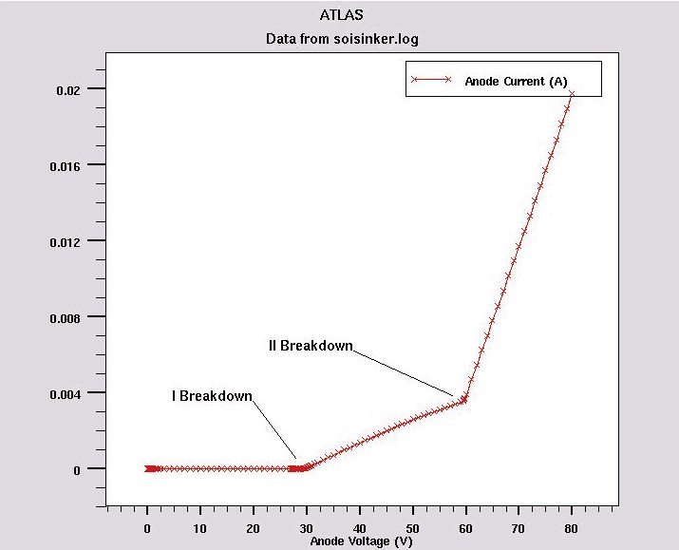
Device Simulation
© Alan P. Morrison
March 2009

Slide 20
In fab characterisation and process monitoring
    oxide thickness
    - monitor thermally grown and deposited oxide film thickness
    sheet resistance
    - monitor resistance change due to activated implant
    etch rates
    - test wafers are used to determine the length of time required to etch a particular oxide film
    visual inspection of lithographic features
    - used to ensure correct pattern transfer
    - used to ensure contact holes are correctly opened
    - used to check cleanliness of wafers and resist removal
    metal reflectivity
    - used to ensure the quality of evaporated or deposited metal films
© Alan P. Morrison
March 2009

Slide 21
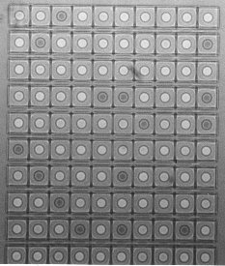
In process characterisation
Visual inspection of wafers
  staining evident
  caused by incomplete oxide removal
Problems caught early in process can be corrected
March 2009
© Alan P. Morrison

Slide 22
Post process characterisation
SEM
  examine sample cross section
  measure SOI thickness etc...
Spreading Resistance Profiling (SRP)
  measure doping profile of device
Secondary Ion Mass Spectroscopy (SIMS)
  measure dopant concentration and impurity concentration
  used to measure segregation of boron into oxide
Emission microscopy
  examination of junction breakdown and microplasmas
© Alan P. Morrison
March 2009

Slide 23
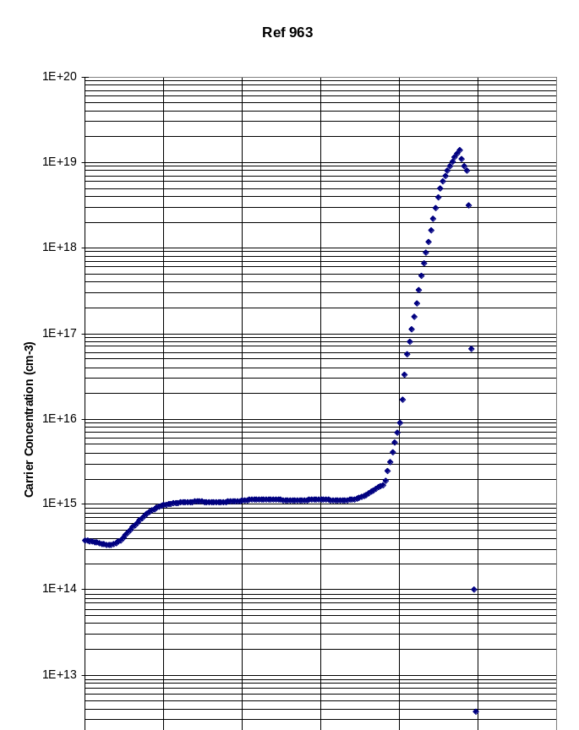
Spreading resistance profile
Used to look at actual doping profile
March 2009
© Alan P. Morrison

Slide 24
Device reverse engineering - defect characterisation
Alternate Secco etch
  highlights presents of defects in device
Emission microscope
  measure distribution and density of microplasmas
© Alan P. Morrison
March 2009

Slide 25
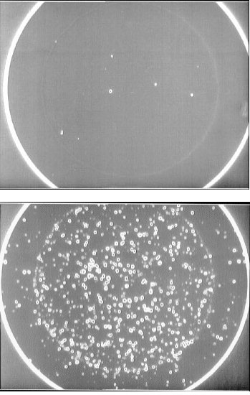
Comparison (negative image)
between two SPADs of
identical area, using two
different process sequences.
The large number of defects
present in bottom device
precludes it from working
as a SPAD.
© Alan P. Morrison
March 2009

Slide 26
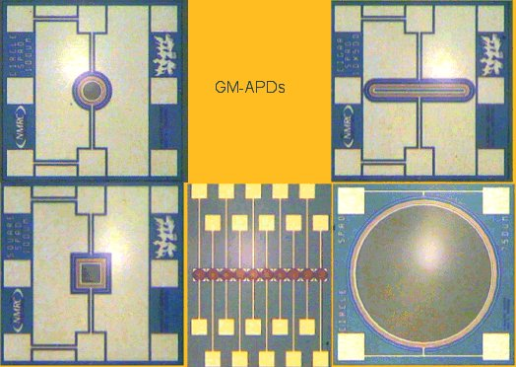
Typical devices
© Alan P. Morrison
March 2009

Slide 27
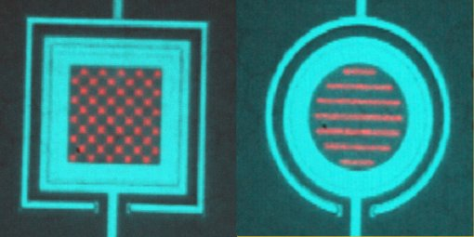
Patented Devices
© Alan P. Morrison
March 2009

Slide 28
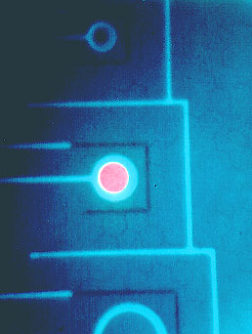
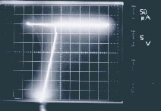
GM-APDs in Breakdown
© Alan P. Morrison
March 2009

Slide 29
Application Areas
Replacements for photomultiplier tubes (PMTs)
Astronomy
  Spectroscopic imaging of distant stars
  Guide star alignment
Biology/Biomedical
  DNA sequencing
  Fluorescence lifetime measurement
  Fluorescence correlation spectroscopy
Measurement
  LIDAR
  OTDR
  Laser scanning microscopy
Quantum optics
POF communications
© Alan P. Morrison
March 2009

